Slide 1
Natural Language Processing

Slide 2
About the Course
CS6501: Vision and Language
Instructor: Vicente Ordonez
Email: vicente@virginia.edu
Website: http://www.cs.virginia.edu/~vicente/vislang
Location: Thornton Hall E316
Times: Tuesday - Thursday 12:30PM - 1:45PM
Faculty Office hours: Tuesdays 3 - 4pm (Rice 310)
Discuss in Piazza: http://piazza.com/virginia/spring2017/cs6501004

Slide 3
Grading Criteria
Project (50pts)
Labs (30pts) [5pts + 5pts + 10pts + 10pts].
Student Paper Review / Participation (10pts)
Paper summaries (10pts)
An optional lab to replace the lowest grade in a Lab.
No late submissions

Slide 4
Grading Criteria: Student Paper Review (10pts) (Groups of 2 students).
Need to present a recent research paper in the class.
Presentations will be in groups of three.
Pick a paper from the syllabus.
Some slots are open to suggestions, you pick the paper (contact the instructor)
Need to prepare slides, send them by email to instructor at least the day before the session.
Presentations should be carefully planned to only use 20 minutes.

Slide 5
Today
Have an overview of Natural Language Processing.
How to represent a word?
How to represent a sentence?
How to generate text?
Other NLP Tasks.

Slide 6
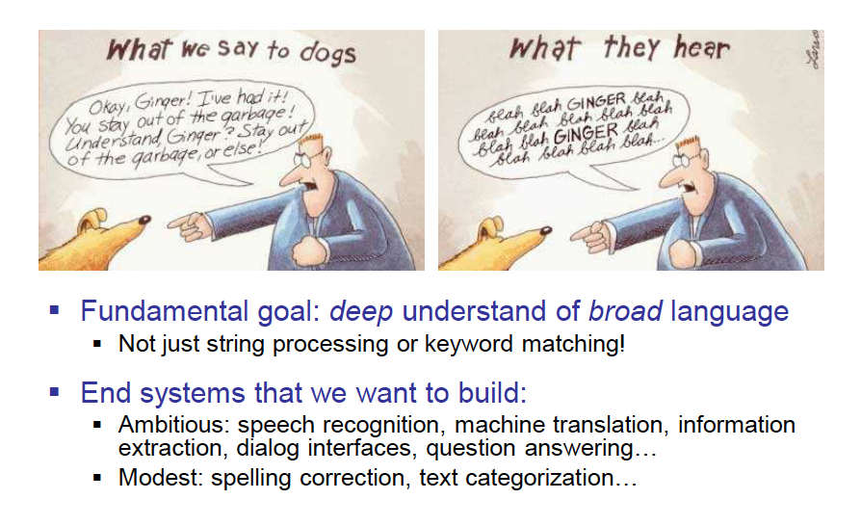
Slide by Dan Klein

Slide 7
Why is NLP hard?
Notes:
Why do you think nlp is difficult?

Slide 8
Why is NLP hard?
Reason (1) – human language is ambiguous.
Task: Pronoun Resolution
Jack drank the wine on the table. It was red and round.
Jack saw Sam at the party. He went back to the bar to get another drink.
Jack saw Sam at the party. He clearly had drunk too much.
[Adapted from Wilks (1975)]
Slide from Yejin Choi

Slide 9
Why is NLP hard?
Reason (1) – human language is ambiguous
Task: Preposition Attachment (aka PP-attachment)
I ate the bread with pecans.
I ate the bread with fingers.
Slide from Yejin Choi

Slide 10
Why is NLP hard?
Reason (2) – requires reasoning beyond what is explicitly mentioned (A,B) , and some of the reasoning requires world knowledge (C)
I couldn’t submit my homework because my horse ate it.
Implies that…
I have a horse.
I did my homework.
My homework was done on a soft object (such as papers) as opposed to a hard/heavy object (such as a computer). – it’s more likely that my horse ate papers than a computer.
Slide from Yejin Choi

Slide 11
Why is NLP hard?
Reason (3) – Language is difficult even for humans.
Learning mother tongue (native language)
-- you might think it’s easy, but…
compare 5 year old V.S. 10 year old V.S. 20 year old
Learning foreign languages
– even harder
Slide from Yejin Choi

Slide 12
Is NLP really that hard?
In the back of your mind, if you’re still thinking…
“My native language is so easy. How hard can it be to type all the grammar rules, and idioms, etc into a software program? Sure it might take a while, but with enough people and money, it should be doable!”
You are not alone!
Slide from Yejin Choi

Slide 13
Brief History of NLP
Mid 1950’s – mid 1960’s: Birth of NLP and Linguistics
At first, people thought NLP is easy! Researchers predicted that “machine translation” can be solved in 3 years or so.
Mostly hand-coded rules / linguistics-oriented approaches
The 3 year project continued for 10 years, but still no good result, despite the significant amount of expenditure.
Mid 1960’s – Mid 1970’s: A Dark Era
After the initial hype, a dark era follows -- people started believing that machine translation is impossible, and most abandoned research for NLP.
Slide from Yejin Choi

Slide 14
Brief History of NLP
1970’s and early 1980’s – Slow Revival of NLP
Some research activities revived, but the emphasis is still on linguistically oriented, working on small toy problems with weak empirical evaluation
Late 1980’s and 1990’s – Statistical Revolution!
By this time, the computing power increased substantially .
Data-driven, statistical approaches with simple representation win over complex hand-coded linguistic rules.
“Whenever I fire a linguist our machine translation performance improves.” (Jelinek, 1988)
2000’s – Statistics Powered by Linguistic Insights
With more sophistication with the statistical models, richer linguistic representation starts finding a new value.
Slide from Yejin Choi

Slide 15
Ambiguity is Explosive
Ambiguities compound to generate enormous numbers of possible interpretations.
In English, a sentence ending in n prepositional phrases has over 2^{n} syntactic interpretations.
“I saw the man with the telescope”: 2 parses
“I saw the man on the hill with the telescope.”: 5 parses
“I saw the man on the hill in Texas with the telescope”: 14 parses
“I saw the man on the hill in Texas with the telescope at noon.”: 42 parses
“I saw the man on the hill in Texas with the telescope at noon on Monday” 132 parses
Slide from Ray Mooney
Notes:
15

Slide 16
Humor and Ambiguity
Many jokes rely on the ambiguity of language:
Groucho Marx: One morning I shot an elephant in my pajamas. How he got into my pajamas, I’ll never know.
She criticized my apartment, so I knocked her flat.
Noah took all of the animals on the ark in pairs. Except the worms, they came in apples.
Policeman to little boy: “We are looking for a thief with a bicycle.” Little boy: “Wouldn’t you be better using your eyes.”
Why is the teacher wearing sun-glasses. Because the class is so bright.
Slide from Ray Mooney

Slide 17
Why is Language Ambiguous?
Slide from Ray Mooney
Notes:
Why do you think language is ambiguous?

Slide 18
Why is Language Ambiguous?
Having a unique linguistic expression for every possible conceptualization that could be conveyed would make language overly complex and linguistic expressions unnecessarily long.
Allowing resolvable ambiguity permits shorter linguistic expressions, i.e. data compression.
Language relies on people’s ability to use their knowledge and inference abilities to properly resolve ambiguities.
Infrequently, disambiguation fails, i.e. the compression is lossy.
Slide from Ray Mooney

Slide 19
Natural Languages vs. Computer Languages
Ambiguity is the primary difference between natural and computer languages.
Formal programming languages are designed to be unambiguous, i.e. they can be defined by a grammar that produces a unique parse for each sentence in the language.
Programming languages are also designed for efficient (deterministic) parsing.
Slide from Ray Mooney

Slide 20
Natural Language Tasks
Slide from Ray Mooney
Processing natural language text involves many various syntactic, semantic and pragmatic tasks in addition to other problems.

Slide 21
Syntactic Tasks
Slide from Ray Mooney
Notes:
Some example syntactic tasks are things like

Slide 22
Word Segmentation
Slide from Ray Mooney
Breaking a string of characters into a sequence of words.
In some written languages (e.g. Chinese) words are not separated by spaces.
Even in English, characters other than white-space can be used to separate words [e.g. , ; . - : ( ) ]
Examples from English URLs:
jumptheshark.com ⇒ jump the shark .com
myspace.com/pluckerswingbar
⇒ myspace .com pluckers wing bar
⇒ myspace .com plucker swing bar

Slide 23
Morphological Analysis
Morphology is the field of linguistics that studies the internal structure of words. (Wikipedia)
A morpheme is the smallest linguistic unit that has semantic meaning (Wikipedia)
e.g. “carry”, “pre”, “ed”, “ly”, “s”
Morphological analysis is the task of segmenting a word into its morphemes:
carried ⇒ carry + ed (past tense)
independently ⇒ in + (depend + ent) + ly
Googlers ⇒ (Google + er) + s (plural)
unlockable ⇒ un + (lock + able) ?
⇒ (un + lock) + able ?
Slide from Ray Mooney

Slide 24
Part Of Speech (POS) Tagging
Annotate each word in a sentence with a part-of-speech.
Useful for subsequent syntactic parsing and word sense disambiguation.
I ate the spaghetti with meatballs.
Pro V Det N Prep N
John saw the saw and decided to take it to the table.
PN V Det N Con V Part V Pro Prep Det N
Slide from Ray Mooney
Notes:
Word sense disambiguation, e.g. bank (can be noun or verb, e.g. bank the ball off the side vs I got some money from the bank)

Slide 25
Phrase Chunking
Slide from Ray Mooney
Find all noun phrases (NPs) and verb phrases (VPs) in a sentence.
[NP I] [VP ate] [NP the spaghetti] [PP with] [NP meatballs].
[NP He ] [VP reckons ] [NP the current account deficit ] [VP will narrow ] [PP to ] [NP only # 1.8 billion ] [PP in ] [NP September ]
Notes:
Break sentences down into phrasal units

Slide 26
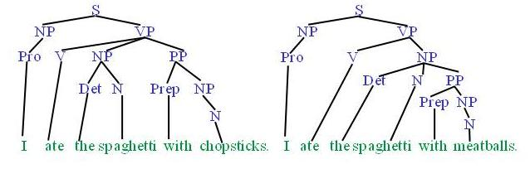
Syntactic Parsing
Slide from Ray Mooney
Produce the correct syntactic parse tree for a sentence.
Notes:
And at a higher level can automatically produce a complete syntactic parse tree for a sentence

Slide 27
Semantic Tasks
Slide from Ray Mooney

Slide 28
Word Sense Disambiguation (WSD)
Words in natural language usually have a fair number of different possible meanings.
Ellen has a strong interest in computational linguistics.
Ellen pays a large amount of interest on her credit card.
For many tasks (question answering, translation), the proper sense of each ambiguous word in a sentence must be determined.
Slide from Ray Mooney

Slide 29
Semantic Role Labeling (SRL)
For each clause, determine the semantic role played by each noun phrase that is an argument to the verb.
agent patient source destination instrument
John drove Mary from Austin to Dallas in his Toyota Prius.
The hammer broke the window.
Also referred to a “case role analysis,” “thematic analysis,” and “shallow semantic parsing”
Slide from Ray Mooney

Slide 30
Textual Entailment
Slide from Ray Mooney
Determine whether one natural language sentence entails (implies) another under an ordinary interpretation.

Slide 31
Textual Entailment Problems from PASCAL Challenge
TEXT | HYPOTHESIS | ENTAIL MENT
Eyeing the huge market potential, currently led by Google, Yahoo took over search company Overture Services Inc last year. | Yahoo bought Overture. | TRUE
Microsoft's rival Sun Microsystems Inc. bought Star Office last month and plans to boost its development as a Web-based device running over the Net on personal computers and Internet appliances. | Microsoft bought Star Office. | FALSE
The National Institute for Psychobiology in Israel was established in May 1971 as the Israel Center for Psychobiology by Prof. Joel. | Israel was established in May 1971. | FALSE
Since its formation in 1948, Israel fought many wars with neighboring Arab countries. | Israel was established in 1948. | TRUE
Slide from Ray Mooney

Slide 32
Pragmatics/Discourse Tasks
Slide from Ray Mooney

Slide 33
Anaphora Resolution/ Co-Reference
Determine which phrases in a document refer to the same underlying entity.
John put the carrot on the plate and ate it.
Bush started the war in Iraq. But the president needed the consent of Congress.
Some cases require difficult reasoning.
Today was Jack's birthday. Penny and Janet went to the store. They were going to get presents. Janet decided to get a kite. "Don't do that," said Penny. "Jack has a kite. He will make you take it back."
Slide from Ray Mooney

Slide 34
Representation vs Computability
simple & plain
complex & rich
intractable
practical & tractable
Slide from Yejin Choi

Slide 35
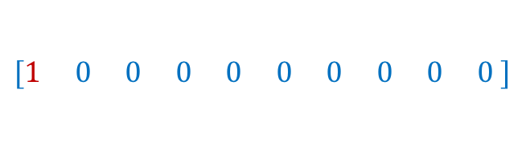
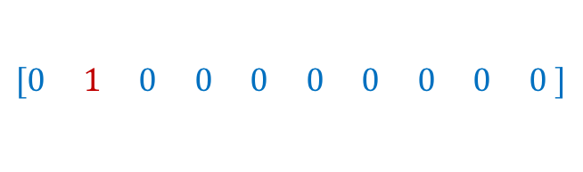
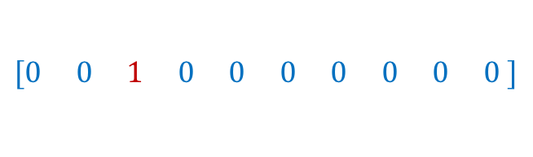
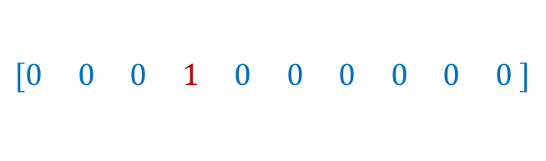
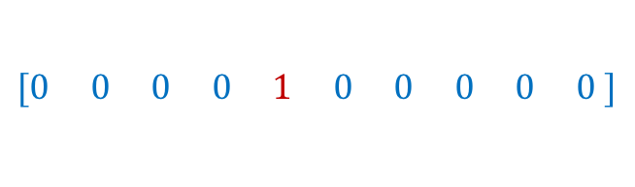
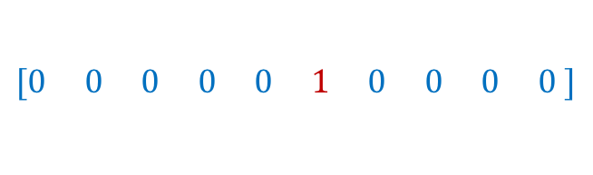
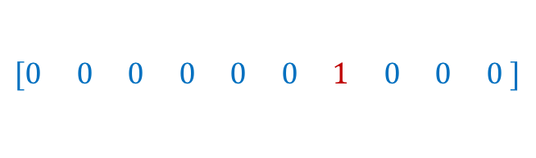
How to represent a word?
one-hot encodings
dog
cat
person
holding
tree
computer
using
1
2
3
4
5
6
7
$$[1 0 0 0 0 0 0 0 0 0 ]$$
$$[0 1 0 0 0 0 0 0 0 0 ]$$
$$[0 0 1 0 0 0 0 0 0 0 ]$$
$$[0 0 0 1 0 0 0 0 0 0 ]$$
$$[0 0 0 0 1 0 0 0 0 0 ]$$
$$[0 0 0 0 0 1 0 0 0 0 ]$$
$$[0 0 0 0 0 0 1 0 0 0 ]$$
What we see

Slide 36
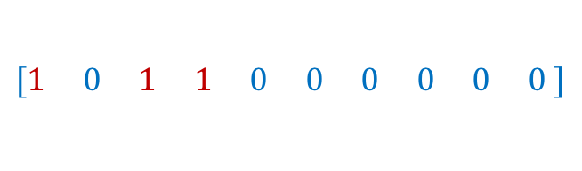
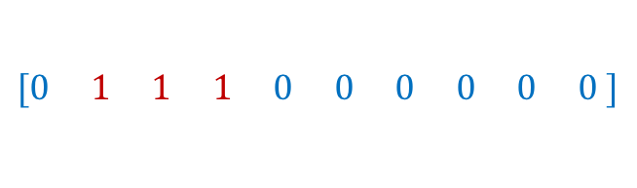
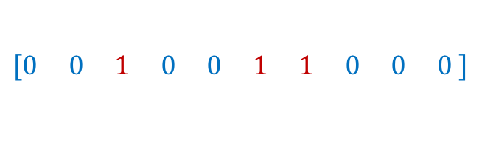
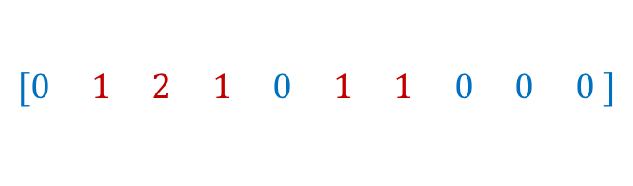
How to represent a phrase/sentence?
bag-of-words representation
person holding dog
{1, 3, 4}
$$[1 0 1 1 0 0 0 0 0 0 ]$$
person holding cat
{2, 3, 4}
dog
cat
person
holding
tree
computer
using
$$[0 1 1 1 0 0 0 0 0 0 ]$$
person using computer
{3, 7, 6}
$$[0 0 1 0 0 1 1 0 0 0 ]$$
person using computer person holding cat
{3, 3, 7, 6, 2}
$$[0 1 2 1 0 1 1 0 0 0 ]$$
What we see
What if vocabulary is very large?

Slide 37
Sparse Representation
bag-of-words representation
person holding dog
{1, 3, 4}
indices = [1, 3, 4] values = [1, 1, 1]
person holding cat
{2, 3, 4}
indices = [2, 3, 4] values = [1, 1, 1]
person using computer
{3, 7, 6}
indices = [3, 7, 6] values = [1, 1, 1]
person using computer person holding cat
{3, 3, 7, 6, 2}
indices = [3, 7, 6, 2] values = [2, 1, 1, 1]
What we see

Slide 38
Recap
Bag-of-words encodings for text (e.g. sentences, paragraphs, captions, etc)
You can take a set of sentences/documents and classify them, cluster them, or compute distances between them using this representation.

Slide 39
Problem with this bag-of-words representation
my friend makes a nice meal
These would be the same using bag-of-words
my nice friend makes a meal

Slide 40
Bag of Bi-grams
indices = [10132, 21342, 43233, 53123, 64233] values = [1, 1, 1, 1, 1]
my friend makes a nice meal
{my friend, friend makes, makes a, a nice, nice meal}
indices = [10232, 43133, 21342, 43233, 54233] values = [1, 1, 1, 1, 1]
my nice friend makes a meal
{my nice, nice friend, friend makes, makes a, a meal}
A dense vector-representation would be very inefficient Think about tri-grams and n-grams
What we see

Slide 41
Problem with this bag-of-words representation
my friend makes a nice meal
No real solution for this yet.
chicken makes a nice meal

Slide 42
Back to how to represent a word?
Problem: distance between words using one-hot encodings always the same
dog
cat
person
1
2
3
$$[1 0 0 0 0 0 0 0 0 0 ]$$
$$[0 1 0 0 0 0 0 0 0 0 ]$$
$$[0 0 1 0 0 0 0 0 0 0 ]$$
Idea: Instead of one-hot-encoding use a histogram of commonly co-occurring words.
What we see

Slide 43
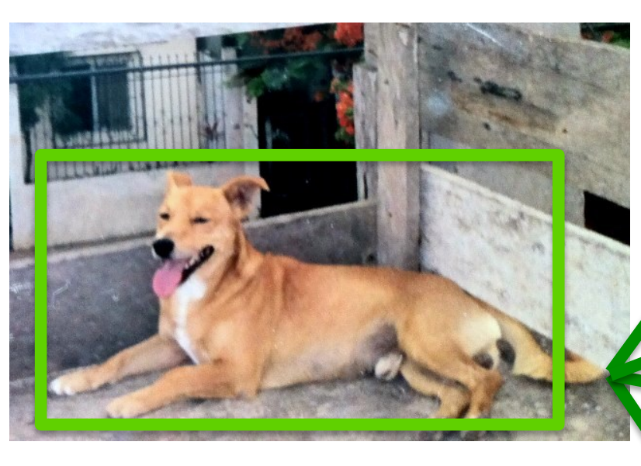
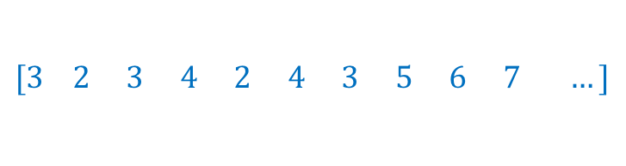
Distributional Semantics
Dogs are man’s best friend.
I saw a dog on a leash walking in the park.
friend
leash
park
walking
walks
food
legs
runs
sleeps
sits
…
His dog is his best companion.
He walks his dog in the late afternoon
…
dog
$$[3 2 3 4 2 4 3 5 6 7 …]$$
What we see

Slide 44
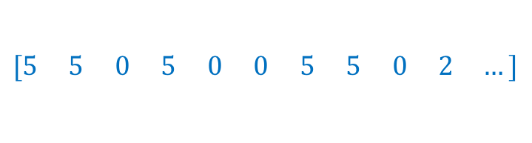
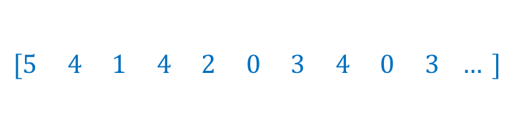
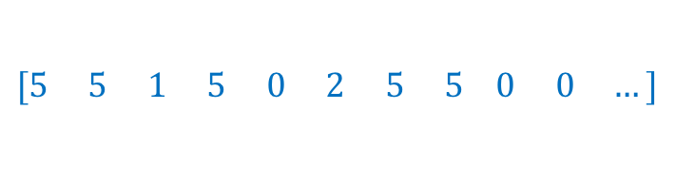
Distributional Semantics
food
walks
window
runs
mouse
invented
legs
sleeps
mirror
tail
…
dog
cat
person
$$[5 5 0 5 0 0 5 5 0 2 …]$$
$$[5 4 1 4 2 0 3 4 0 3 … ]$$
$$[5 5 1 5 0 2 5 5 0 0 …]$$
This vocabulary can be extremely large
What we see

Slide 45
Toward more Compact Representations
food
walks
window
runs
mouse
invented
legs
sleeps
mirror
tail
…
dog
cat
person
$$[5 5 0 5 0 0 5 5 0 2 …]$$
$$[5 4 1 4 2 0 3 4 0 3 … ]$$
$$[5 5 1 5 0 2 5 5 0 0 …]$$
This vocabulary can be extremely large
What we see

Slide 46
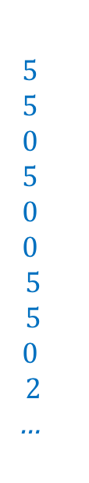
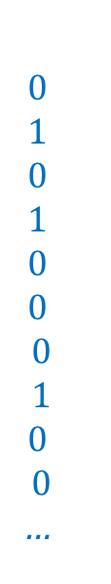
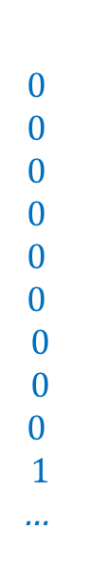
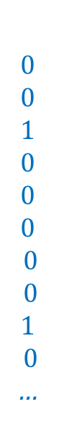
Toward more Compact Representations
$$5$$
$$5$$
$$0$$
$$5$$
$$0$$
$$0$$
$$5$$
$$5$$
$$0$$
$$2$$
…
$$0$$
$$1$$
$$0$$
$$1$$
$$0$$
$$0$$
$$0$$
$$1$$
$$0$$
$$0$$
…
$$0$$
$$0$$
$$0$$
$$0$$
$$0$$
$$0$$
$$0$$
$$0$$
$$0$$
$$1$$
…
$$0$$
$$0$$
$$1$$
$$0$$
$$0$$
$$0$$
$$0$$
$$0$$
$$1$$
$$0$$
…
dog =
=
w1
+ w2
+ w3
+ …
What we see
legs, running, walking
tail, fur,
ears
mirror, window, door

Slide 47
Toward more Compact Representations
dog =
w1
w2
w3
The basis vectors can be found using Principal Component Analysis (PCA)
This is known as Latent Semantic Analysis in NLP
What we see

Slide 48
Toward more Compact Representations: Word Embeddings
dog =
w1
w2
w3
The weights w1, …, wn are found using a neural network
We will have a session about word embeddings later
Word2Vec: https://arxiv.org/abs/1301.3781
What we see

Slide 49
Required reading: n-gram language models
Kai-Wei’s course on Natural Language Processing
http://www.cs.virginia.edu/~kc2wc/teaching/NLP16/slides/02-ngram.pdf
http://www.cs.virginia.edu/~kc2wc/teaching/NLP16/slides/03-smooth.pdf
Yejin Choi’s course on Natural Language Processing
http://www3.cs.stonybrook.edu/~ychoi/cse628/lecture/02-ngram.pdf

Slide 50
Questions?

